Slide 1

Mining 2024
Industry Overview

Slide 2
Overview

Slide 3
Mining is at the heart of the U.S. economy. By delivering the materials required for nearly every industry and consumer product, feeding our manufacturing, technology, energy, transportation, medical, and defense supply chains — mining provides the resources for a better future.

Slide 4
Mining at
a Glance
483,000
Number of direct mining industry jobs.¹
833,000
Number of indirect jobs generated by the mining industry.¹
$91,000+
Average annual salary for
a miner, well above the U.S. average wage of $70,000.²
40,000 lbs.
Average weight of newly
mined materials used by every American each year, including two tons of coal.³
$136B
Annual U.S. revenues generated through mining.⁴
Notes:
¹ Source: Based on Mine Safety & Health Administration (MSHA) 2023 employment data and 2018 IMPLAN economic multipliers.
² Bureau of Labor Statistics, http://www.bls.gov/cew/
³ Minerals Education Coalition, https://mineralseducationcoalition.org/mining-mineral-statistics, NMA calculations using USGS, MCS 2022
⁴ USGS, Mineral Commodity Summaries 2024, Table 1

Slide 5
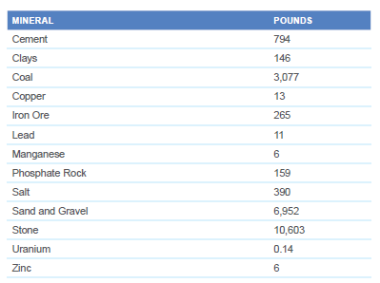
U.S. Per Capita Consumption of Minerals and Coal
NMA calculations based on preliminary
USGS, EIA and U.S. Census Bureau data
The National Mining Association | Mining 2024 Industry Overview | 5

Slide 6
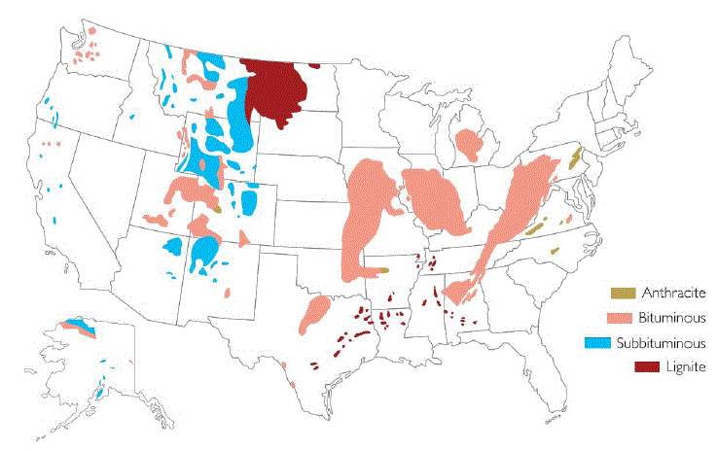
Coal: Reserves in the United States
Total U.S. Coal Reserves – 250 Billion Short Tons (2022)
Sources: NMA; EIA
The National Mining Association | Mining 2024 Industry Overview | 6

Slide 7
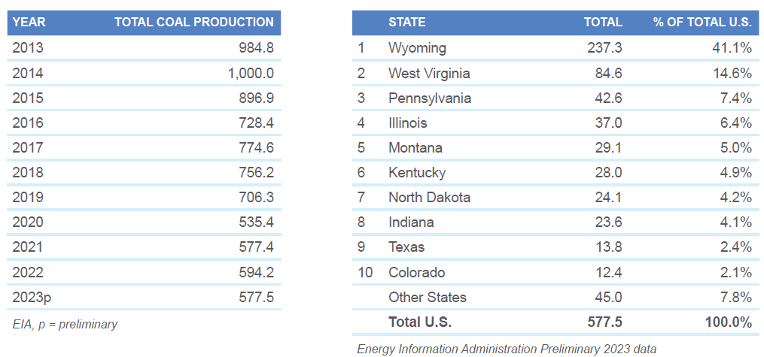
Coal: U.S. Production (million short tons)
The National Mining Association | Mining 2024 Industry Overview | 7

Slide 8
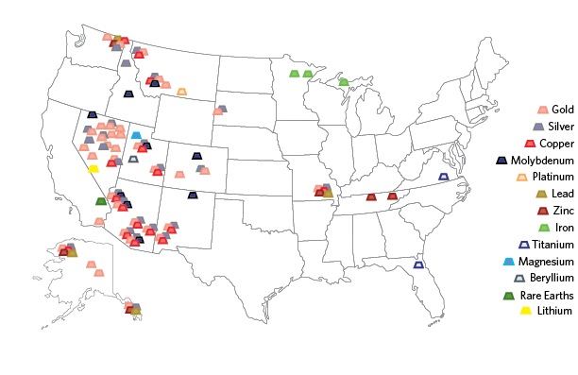
Minerals: Major Metal Producing Areas
The National Mining Association | Mining 2024 Industry Overview | 8
Source: U.S. Geological Survey

Slide 9
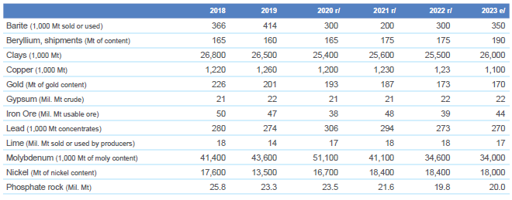
Minerals: Production Statistics of Selected Minerals 2018–2023
The National Mining Association | Mining 2024 Industry Overview | 9

Slide 10
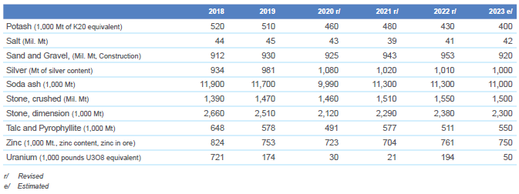
Minerals: Production Statistics of Selected Minerals 2018–2023 (cont’d)
Source: USGS
The National Mining Association | Mining 2017 Industry Overview | 10
The National Mining Association | Mining 2024 Industry Overview | 10

Slide 11
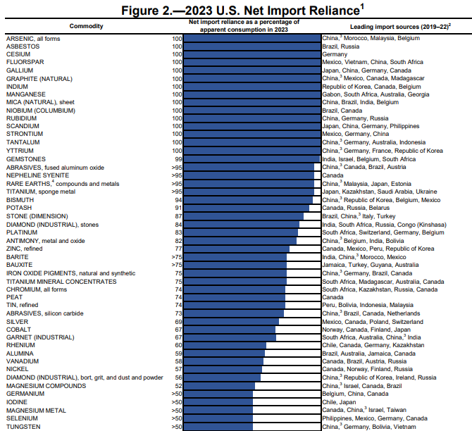
The U.S. is currently
100% import reliant for
15 minerals and
more than 50% import reliant for another 34
Source: USGS
Notes:
¹ Not all mineral commodities included.
² Listed in descending order of import share.
³ Includes Hong Kong
⁴ Includes lanthanides cerium, dysprosium, erbium, gadolinium, holminium, lanthium, lutetium, neodymium, praseodymium, samarium, terbium, thulium and ytterbium.

Slide 12
A Heavily
Regulated Industry

Slide 13
Major Laws Applicable to Mining Operations
Federal
Surface Mining Control and Reclamation Act
National Environmental Policy Act
Clean Water Act
Clean Air Act
Resource Conservation and Recovery Act
Comprehensive Environmental Response, Compensation and Liability Act (Superfund)
Toxic Substances Control Act
Emergency Planning and Community Right-to-Know Act
Endangered Species Act
National Historic Preservation Act
Federal Land Policy Management Act
National Forest Management Act
Antiquities Act
State
State environmental policy acts
State surface water discharge permits
State ground water protection laws or regulations
Storm water permits
Construction permits for dams or impoundments
Air quality permits
Solid waste disposal
Water appropriation permits
Mine operating permits
Reclamation plan approvals or permits
Reclamation bonding
Environmental performance bonding
The National Mining Association | Mining 2024 Industry Overview | 13

Slide 14
Providing the Resources for a Better Life

Slide 15
Mining for Our Future
Innovative technologies made possible through and employed by mining are providing the mineral and energy resources essential for a better life and a better future.
  Advancing innovation. Minerals are supporting innovation everywhere you look, from electric vehicles that depend on their conductivity to medical applications that utilize their antimicrobial capabilities.
  Utilizing innovation. Advanced technologies are making combustion of coal more efficient and cleaner every day. Dramatic reductions of sulfur dioxide, nitrogen oxide and particulate matter that have already been achieved show how advancements in emissions technology, including carbon capture utilization and storage, hold even more promise for the future. And affordable, commercially-available high efficiency, low emissions technologies are capable of cutting U.S. coal-plant CO2 emissions by up to 35 percent.
The National Mining Association | Mining 2024 Industry Overview | 15

Slide 16
Spurring Innovation
67
Number of carbon capture, use and storage facilities across all applications under construction or operating around the world. ⁶
1,000%
Mining is key to advancing technologies for the future.
5x
Increase in lithium needs by 2030.³
4.7 tons
Amount of copper needed for a single wind turbine.⁷
Projected increase in demand for minerals needed for future energy technologies, according to the Center for Strategic and International Studies.¹
1/5 of a gram
Amount of gold in the average computer, used in many electronics due to its high corrosion resistance.⁴
14%
Amount of global silver demand utilized in the production of solar panels.⁵
300+
Number of new mines needed by 2035 just to fulfill battery demands.⁸
6x
A typical electric car requires six times the mineral inputs of a conventional car.²
Notes:
¹ CSIS analysis
² IEA analysis
³ https://www.reuters.com/markets/commodities/global-demand-lithium-batteries-leap-five-fold-by-2030-li-bridge-2023-02-15/
⁴ https://interestingengineering.com/how-much-gold-is-in-your-computer-and-how-efficient-it-is-to-reclaim-it
⁵ World Silver Institute, Silver Survey 2023
⁶ Global CCS Institute website
⁷ Copper Development Association website
⁸ Benchmark Minerals

Slide 17
U.S. Economy
100,000
Number of direct coal mining industry jobs.¹
224,000
Number of indirect coal mining jobs.²
Mining provides essential power and materials for nearly every industry and consumer product, and supplies low-cost, reliable fuel for homes and businesses across the country.
383,000
Number of direct minerals mining industry jobs.¹
609,000
Number of indirect minerals mining jobs.²
$18,000,000,000
Amount of federal, state and local taxes attributable to mining.⁴
Notes:
¹ Based on Mine Safety & Health Administration (MSHA) 2023 preliminary employment data and 2018 IMPLAN economic multipliers and includes those involved in the transportation of coal and minerals, and support activities.
² Based on Mine Safety & Health Administration (MSHA) 2023 employment data and 2018 IMPLAN economic multipliers.
³ Economic Contributions of Mining, http://nma.org/pdf/fact_sheets/ecm.pdf
⁴ Ibid.
⁵ Ibid.

Slide 18
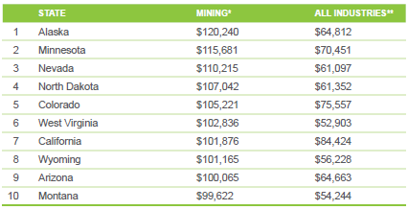
Annual Mining Wages vs. All Industries, 2022
Excludes oil and gas extraction
Average wages
Source: U.S. Bureau of Labor Statistics
The National Mining Association | Mining 2017 Industry Overview | 18
The National Mining Association | Mining 2024 Industry Overview | 18

Slide 19
Resources that Power our Lives
$170,000 kg
Amount of steelmaking coal used in the average wind turbine.¹
29
Number of minerals it takes to deliver electricity to our homes and businesses.⁴
Americans expect reliable and affordable energy, powered by a diverse mix of coal, natural gas, nuclear power, oil and renewable sources. Diversification ensures that U.S. households and businesses can minimize market disruptions, making electricity accessible and affordable to all.
16%
Amount of U.S. electricity that comes from coal.²
85%
Amount of U.S. fossil energy reserves (coal, natural gas and oil) that comes from coal on a BTU basis.⁵
18%
Amount of electricity generated from nuclear energy powered by uranium.³
22%
Portion of total world coal reserves held by the U.S., the most of any country.⁶
Notes:
¹ Atlantic Council report, The Role of Minerals in U.S. Transportation Electrification Goals, The role of minerals in US transportation electrification goals - Atlantic Council
² Energy Information Administration, http://www.eia.gov/totalenergy/data/monthly/pdf/sec7_5.pdf
³ Energy Information Administration, http://www.eia.gov/totalenergy/data/monthly/pdf/sec7_5.pdf
⁴ IEA, The Role of Critical Minerals in Clean Energy Transitions – Analysis - IEA.
⁵ Energy Information Administration, calculated using: Total Energy Monthly Data - U.S. Energy Information Administration (EIA); Total Energy Monthly Data - U.S. Energy Information Administration (EIA); ACR - table15.pdf (eia.gov)
⁶ BP Statistical Review of World Energy June 2021, http://www.bp.com/en/global/corporate/energy-economics/statistical-review-of-world-energy.html

Slide 20
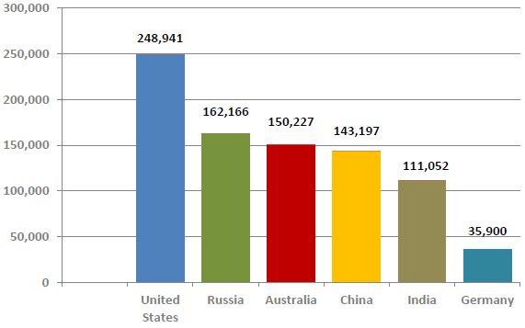
Coal: World Recoverable Reserves
(million metric tons)
Source: BP Statistical
Review of World Energy, 2021
The National Mining Association | Mining 2024 Industry Overview | 20

Slide 21
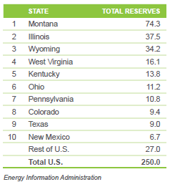
Coal: U.S. Recoverable Reserve Base, 2022
Top 10 States (billion short tons)
The National Mining Association | Mining 2024 Industry Overview | 21
The National Mining Association | Mining 2017 Industry Overview | 21

Slide 22
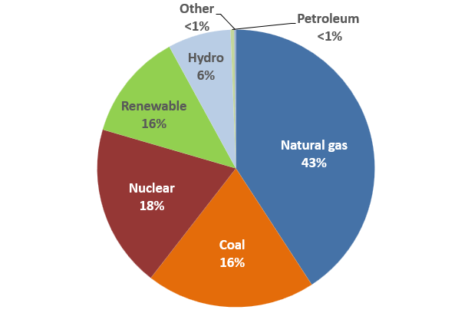
Coal-Based Power Generation Share, 2023
Source: Energy Information Administration
2023 share data are preliminary through November 2023
The National Mining Association | Mining 2017 Industry Overview | 22
The National Mining Association | Mining 2024 Industry Overview | 22

Slide 23
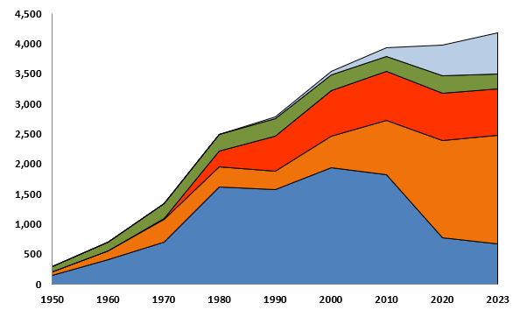

U.S. Electric Power Sector Net Generation
1950–2023 (Billion kWh)
Source:
Energy Information Administration.
The National Mining Association | Mining 2017 Industry Overview | 23
The National Mining Association | Mining 2024 Industry Overview | 23

Slide 24
45%
Amount of U.S. copper demand that goes to the construction industry.¹
Foundation
of America’s Infrastructure
70%
Portion of the world’s steel produced using coal.⁵
6 million
Tons of steel used in the U.S. National Highway System.²
67%
Portion of global zinc consumption used to coat steel, making it highly resistant to corrosion.⁶
439 lbs.
Amount of copper used in the average American home.³
America’s miners play an indispensable role in building our nation. From foundations to roofs, power plants to wind farms, roads and bridges to communications grids and data storage centers—America’s infrastructure projects begin with mining.
22%
Amount of U.S. copper used in electrical infrastructure and electronic products.⁷
90%
Average amount of kyanite transformed into mullite, an essential material for infrastructure because of its heat resistance, used in refractory and ceramic products. It is also used in many electronics – from electrical insulators to spark plugs.⁴
85%
Portion of U.S. nickel consumed to make heat and corrosive
resistant alloys.
Notes:
¹ USGS, http://minerals.usgs.gov/minerals/pubs/commodity/copper/mcs-2022-copper.pdf
² USGS, https://pubs.usgs.gov/fs/2006/3127/2006-3127.pdf
³ Copper Development Association website.
⁴ Minerals Make Life, https://mineralsmakelife.org/resources/minerals-rebuilding-america/
⁵ World Steel Association, https://www.worldsteel.org/publications/fact-sheets/content/00/text_files/file0/document/fact_raw%20materials_2014.pdf
⁶ International Lead Zinc Study Group usage statistics.
⁷ USGS, http://minerals.usgs.gov/minerals/pubs/commodity/copper/mcs-2024-copper.pdf

Slide 25
Ensuring Supply Chain Security
$1.84B
Value of platinum, which
is used in 20 percent of all
manufactured goods, the U.S. imported from Russia in 2021.
Metals and minerals are the building blocks of our energy, manufacturing, technology, defense and medical supply chains. Our reliance on foreign countries and geopolitical rivals for minerals we could be sourcing here at home exposes our economy and way of life to unacceptable risks.
Despite being home to one of the world’s leading minerals reserves, cumbersome permitting processes contribute to the U.S. remaining import-dependent for many key minerals.
82%
Percentage of commodities defined as critical minerals for which the U.S. is more than 50 percent import dependent.¹
$6B
Value of minerals the U.S. imports from foreign countries, despite being home to reserves estimated at $6.2 trillion.³
#1
China is the number 1 supplier of nonfuel mineral commodities for which the U.S. was 50%+ import reliant in 2023.²
49
Number of minerals for which the U.S. is more than 50 percent import reliant.⁴
Notes:
¹ USGS, Mineral Commodity Summaries, 2024
² USGS, Mineral Commodity Summaries, 2024
³ USGS, Mineral Commodity Summaries, 2024
⁴ USGS, Mineral Commodity Summaries, 2024

Slide 26
Safety
The safety and health of our workers and colleagues is a core value of the mining industry. Today’s modern mining companies recognize that continuous performance improvement necessary to achieve the goals of zero fatalities and injuries means going beyond what’s required by regulations.
To accelerate the pace of mine safety improvement, the U.S. mining industry has taken voluntary steps to implement best practices that encourage a “culture of safety.” By identifying and eliminating potential hazards, and deploying state-of-the-art technology, American mining has developed an award-wining safety framework that is bringing more miners home safely after every shift.
58%
Amount by which injuries in U.S. mines have been reduced over the last 15 years.
55%
Amount by which fatalities
in U.S. mines have been
reduced over the last 15 years.
Notes:
Mine Safety & Health Administration, https://www.msha.gov/data-reports/statistics

Slide 27
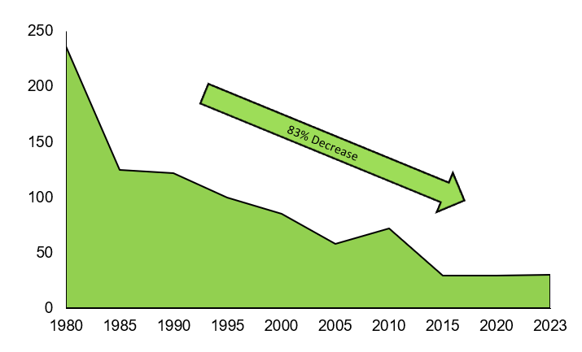
U.S. Mining Fatalities 1980–2023
Source: Mine Safety
& Health Administration
The National Mining Association | Mining 2024 Industry Overview | 27

Slide 28
Environmental Responsibility
90%
Amount by which today’s new coal-fueled power plants have reduced emissions (SO², NO_{x}, particulates and mercury), compared with the typical 1970s plants they replace.¹
Natural resources are at the heart of mining, therefore good environmental stewardship is an industry imperative and a core requirement. Mining and its employees are at the center of our communities, underscoring our commitment to being good neighbors wherever we operate.
Building on the extraordinary environmental progress made in recent decades, the industry is committed to continued technological advancements that make the use of our resources cleaner and more efficient. Even before mining begins, extensive plans are made and funding is secured to support the restoration of land after mining operations have concluded.
3 million
Number of acres of mined land that have been restored by U.S. mining companies to their natural conditions for wildlife habitats or new sites for schools, hospitals or infrastructure projects.²
$12+ billion
Amount the U.S. mining industry has paid to reclaim mines that were abandoned prior to laws requiring reclamation.³
Notes:
¹ Institute for Energy Research (NETL 2009), http://instituteforenergyresearch.org/studies/the-facts-about-air-quality-and-coal-fired-power-plants/
² Office of Surface Mining Reclamation and Enforcement, http://www.osmre.gov/resources/annualReports.shtm
³ Office of Surface Mining Reclamation and Enforcement, http://www.osmre.gov/programs.shtm

Slide 29
Challenges

Slide 30
Abandoned Mined Lands (AML)
The coal industry has paid more than $12 billion into the AML fund to reclaim legacy abandoned mines only to see the majority of those funds disappear.
Just one in two dollars spent by the fund has gone to priority coal projects that the fund was intended to rehabilitate. Approximately $9.4 billion has been spent from the fund. But just $5 billion of priority abandoned coal mined lands were reclaimed as of September 30, 2020, according to the Office of Surface Mining (OSM). The $4.5 billion gap between spending and actual reclamation of priority coal AMLs reveals that just a third of funds have reached projects they were intended to remediate.
The fund has been in existence for almost 45 years—30 years beyond its intended lifespan—and has achieved little of its intended purpose. Many of the issues surrounding the diversion and inefficient use of coal AML fees are not new; they have plagued the program for decades, and they have been examined in congressional hearings, through inspectors general reports, and by other government bodies, all with no improvement.
The Infrastructure bill addressed reauthorization at a rate that more appropriately reflects the current state of the industry. The Infrastructure Investment and Jobs Act (now Public Law 117-58) included a reauthorization of the coal abandoned mine program through 2034 with a 20 percent reduction in fees paid by coal production companies. A remaining issue is discussion regarding the lack of authority to collect fees during the lapse in the program’s collection authority.
The National Mining Association | Mining 2024 Industry Overview | 30

Slide 31
Black Lung: Disease, regulation and research
The NMA is fully committed to continuing to work to improve the health and safety of miners. Over the last two decades, effective ventilation controls, implementation of industry best practices, strict adherence to mine ventilation control plans, increased operator and miner safety awareness, and the 2014 coal dust rule, have all contributed to exponentially lower dust levels inside the mine.
The NMA and its members welcomed the new silica rule that was introduced in 2023, lowering the permissible silica levels. MSHA’s rule should follow the Occupational Safety and Health Administration’s crystalline silica rule on methods of compliance. Specifically, MSHA’s new proposed rule specifically indicates that the use of respiratory protection equipment cannot be used as a method of compliance; we believe this is a mistake.
While the 2014 Dust rule was specific to coal dust, there is evidence that silica dust levels have also declined in recent years. Since 2000, there has been a steady decrease in average silica concentrations detected at underground mine occupations, with the average quartz concentration between the years 2016 and 2018 measuring approximately one-fourth of the allowable MSHA exposure limit. More broadly, in 2018, 99 percent of MSHA-collected quartz samples complied with the allowable standard, a significant improvement from 2000, when 77 percent of MSHA-collected quartz samples complied.
Despite progress that has been made, we have consistently stated that more can be done. One of the challenges that we face in addressing the challenges of this disease is that symptoms do not typically present for 10 years. That means the reported increase in incidences of disease that recent studies have shown involve exposures dating back decades, before the 2014 Dust rule and stricter standards were put into place. That doesn’t mean industry is sitting idly by until the 10-year mark after the dust rule was enacted – we believe that more can be done to gain insight into and address the challenge. For instance:
  All miners should be required to participate in the National Institute for Occupational Safety and Health (NIOSH) Enhanced Surveillance Program.
  The 1/3 voluntarily participation rate does not provide a realistic appraisal of disease frequency across the entirety of the coal mining workforce.
  More importantly, failure to require participation denies the miners, their health care providers and their employers critical information necessary to implement intervention actions, if warranted, during the miners’ working career.
  The government should recognize the use of administrative controls and personal protective equipment (PPE) (such as airstream helmets) to supplement engineering controls. These are recognized industrial hygiene practices utilized in other occupational settings but, to the detriment of miner health, while some operators voluntarily provide PPEs, MSHA does not recognize their use in mining as an acceptable tool to lower exposures.
The National Mining Association | Mining 2024 Industry Overview | 31

Slide 32
Climate
Our industry stands with the rest of the world in its dedication to addressing critical environmental and social matters while continuing to provide the materials that make modern life possible and that will fuel America’s economic recovery.
Leadership at the highest levels. In 2020, the NMA established a CEO-led Environmental, Social and Governance (ESG) Task Force to examine a wide range of ESG issues and policy positions, including climate, and to promote innovative solutions that enhance ESG performance amongst member companies. That process is actively underway and involves constant engagement by U.S. based miners and suppliers to the industry.
Driving innovation. The NMA and its diverse members are committed to being a part of the solution and believe individual companies and leading international organizations focusing on the climate issue can make great contributions, including advancing technological solutions, such as carbon capture, and providing the raw materials required for electric vehicles, renewable energy and battery storage.
The National Mining Association | Mining 2024 Industry Overview | 32

Slide 33
Federal Coal Leasing
Our public lands are intended for multiple use, including the production of affordable, reliable energy for all Americans. Federal coal production provides a fair return to the public, providing hundreds of millions of dollars of federal, state and local revenue per year and a valuable fuel for power generation.
Producers already pay twice. Producers currently pay in sealed bids and are subject to royalties, fees and extraction costs.
The current program benefits American taxpayers. The current federal coal leasing program pays extraordinary dividends to American taxpayers and consumers.
  $1 billion in revenues for American taxpayers.
  Taxpayers receive almost 40 cents on every dollar of coal sales.
The National Mining Association | Mining 2024 Industry Overview | 33

Slide 34
Land Withdrawals
New mining operations are already either restricted or banned on more than half of all federally-owned public lands. Given the vast amount of federal lands already closed to mining operations, caution should be exercised when determining whether additional lands should be placed off limits. In recent years, large-scale mineral withdrawals under the Federal Land Policy and Management Act have been abused in terms of need and scope.
Import dependence for key mineral commodities should be a concern to all Americans. The U.S. is import dependent for 15 key mineral resources, and more than 50 percent import dependent for an additional 34 mineral commodities – even though we have significant mineral deposits of some of these commodities within our borders.
Less than half of the mineral needs of U.S. manufacturing are met from domestically mined resources. As a result, key domestic industries are unnecessarily vulnerable to disruptions from extended, complex and fragile supply chains.
The National Mining Association | Mining 2024 Industry Overview | 34

Slide 35
Mining Law
A comprehensive network of state and federal laws govern the hardrock mining industry, making it one of the most heavily-regulated industries in the world. The General Mining Law is not an environmental statute. It is complemented by exhaustive federal and state environmental, ecological, reclamation and financial assurance laws and regulations to ensure that operations fully protect public health and safety, the environment, and wildlife.
Mining’s economic contributions to the country and to the communities in which it works are substantial. The U.S. mining industry pays between 40 to 50 percent of earnings in federal, state and local royalties, taxes, and other fees to benefit the communities in which it works and the U.S. federal government.
While the industry has worked toward compromise, punitive tax schemes that have been proposed in the past would push the U.S. beyond the upper limit of the total tax rate in other countries, significantly impairing our global competitiveness. As investments in the U.S. become less attractive, our reliance on foreign sources of minerals creates supply chain vulnerabilities for the U.S. manufacturing, energy, infrastructure, and defense industrial sectors.
Unlike other extractive industries, significant upfront exploratory and long-term project investments required to explore for, extract and refine hardrock minerals make it unlike other extractive industries. It is not unusual for a mining company to spend years exploring for mineral deposits that can be produced economically and then invest hundreds of millions or even billions on the infrastructure needed to produce those minerals. There is no market for minerals in their crude state; they require extensive and expensive refinement before they are saleable.
The National Mining Association | Mining 2024 Industry Overview | 35

Slide 36
EPA Regulatory Overreach
The EPA has repeatedly emphasized its plan to use a full suite of authorities against the coal power sector to accomplish its goal of transforming the energy grid by forcing premature plant retirements. Europe’s self-imposed energy crisis should serve as a warning for the EPA. The same countries that aggressively pursued the closure of coal plants were forced to turn back to coal by reopening plants or delaying plant retirements.
Grid regulators and operators have warned EPA that its regulatory plans pose an ominous threat to reliability, yet EPA is showing no signs of course correction. Intermittent renewable power additions will require a massive expansion of transmission infrastructure and energy storage — an effort that will take years to complete — in order to fill the gulf left by coal plant retirements. In fact, in 2022, as many as 40 planned coal plant retirements were postponed or scrapped largely due to acute grid reliability challenges where utilities and grid operators have made it clear closing plants would be reckless.
The coal fleet continues to play an outsized role in providing dispatchable fuel diversity, fuel security and ramping up power supply during periods of surging demand when other sources of power cannot. Consumers are paying more than they have in years for a supply of power that is less reliable. The EPA must heed the clear warnings and voter concern and change course.
The National Mining Association | Mining 2024 Industry Overview | 36

Slide 37
Permitting Delays
Minerals and metals provide key components to consumer and industrial technologies and will play a critical role in the advancement and successful deployment of future energy technologies. While the U.S. is rich in mineral resources, permitting delays and regulatory uncertainty hamper investment in our domestic resources, increasing our reliance on foreign imports.
U.S. permitting process takes close to 10 years – one of the longest permitting processes in the world. Permitting delays have been called the most significant risk to mining projects in the United States.
Despite being home to reserves estimated at $6.2 trillion, cumbersome permitting processes contribute to the U.S. importing nearly $6 billion in minerals from foreign countries each year. U.S. is import-dependent for 15 key minerals resources and more than 50 percent import-dependent for an additional 34 mineral commodities used in everyday manufacturing and defense applications.
The National Mining Association | Mining 2024 Industry Overview | 37

Slide 38
Waters of the U.S.
The U.S. needs clean water and clear rules. The definition of “Waters of the United States” (WOTUS) has been marred by uncertainty, controversy and litigation for decades. The Obama administration created a rule that was overly broad and blurred the lines between state and federal jurisdiction. Like administrations before it, the Biden administration also crafted it own WOTUS rule – returning to an overly broad definition that sweeps in dry land and isolated features that have not been subject to federal jurisdiction before.
Confusion is back. The result of these ping-ponging rules: increased confusion that will lead to additional costs, delays and financial risks for nearly every sector of the economy, including the mining industry.
The mining industry depends on a clear, predictable and transparent WOTUS rule so companies can protect the environment, operate with certainty, and create jobs in communities. Continual repeals, remands and reintroductions of WOTUS definitions only sow confusion and thwart regulatory certainty. The new WOTUS rule will make economic development more difficult and make it more expensive to invest in U.S. operations and businesses. New projects will become cost-prohibitive, and existing lawful operations will be subjected to increased permitting requirements, delays, undue litigation threats and even potential closures.
The Clean Water Act was intended to provide both vital environmental protections for our nation’s waterways and the regulatory certainty necessary for investment and a thriving economy. The new rule muddies the application of federal regulations, putting both key interests at risk.
The National Mining Association | Mining 2024 Industry Overview | 38

Slide 39
Conclusion

Slide 40
Mining provides the mineral and energy resources essential for a better life and a better future.

